Slide 1
Chapter 10
Managing the Network
Infrastructure

Slide 2
Objectives
Review the functions of IANA
Examine the use of DHCP for assigning IP addresses in a network
Overview of NAT and PAT
Using SNMP for maintaining network equipment
Examine network data traffic
Introduction to Wireshark protocol analyzer
Troubleshooting IP networks

Slide 3
Chapter 10-2
Domain Name and
IP Assignment

Slide 4
Internet Essentials
There two essential components to the Internet when it comes to general population utilizing Internet services.
Internet name
public IP address
These two go hand in hand.
People generally connect to Internet services via Internet hostnames, but behind the scene the Internet name is translated to a public IP address.
Both the IP address assignment and the Intenet domain name are governed at the highest level by the Internet Assigned Numbers Authority or IANA.

Slide 5
IANA
IANA was one of the Internet’s oldest organizations set up to be in charge of the Internet management authorities or registration authorities.
Domain name management
Number resources management
Protocol Assignments

Slide 6
IANA
Domain name management
Manages the DNS root zone for the generic top-level domains (gTLDs)
.COM, .NET, .INFO
Manages the DNS root zone for the country-code top-level domains (ccTLDs)
.US, .UK, .AU.
Maintains the .int domain registries which are exclusive registrations for intergovernmental treaty organizations
the United Nation (un.int) and NATO (nato.int) Asnthe .int

Slide 7
IANA
Maintains the .arpa domain registries which include the in-addr.arpa domain.
The in-addr.arpa is the reverse DNS lookup for IPv4 addresses on the Internet.
Maintains the IDN (Internationalized Domain Name) practices repository known as the language table registry.
This allows for domain name registration containing international characters for example, müller.info.

Slide 8
IANA
Number resources management
Coordinates the global pool of IP addresses which include both IPv4 and IPv6.
IANA delegates the allocation to the regional Internet registries (RIRs), each of which is responsible for a different area.
The five RIRs accounting for the different regions of the world
AfriNIC: Africa Region
APNIC: Asia/Pacific Region
ARIN: North America Region
LACNIC: Latin America and some Caribbean Islands
RIPE NCC: Europe, the Middle East, and Central Asia

Slide 9
IANA
Protocol Assignments
Maintains the registries of protocol names and numbers used in the Internet today
These protocols numbering systems are managed by IANA in conjunction with standards bodies.

Slide 10
Internet Registration
Today, IANA is working under the direct support from the Internet Corporation of Assigned Names and Numbers (ICANN)
However, these organizations do not directly allocate IP address space nor do they register domain names for the general public.
Acquiring a Public IP address pool
Apply for a classful address with ARIN in North America
Justification
IPv4 pool is almost depleted
From your ISP
Business class service

Slide 11
Internet Registration
Acquiring an Internet Domain name
IANA/ICANN delegates to TLD registrars
Educause
Authorized TLD operator for .edu domain
verisign.com
authoritative registry operator the two TLDs: .com and .net
.biz, (restricted to businesses), operated by NeuStar, Inc.
.com, operated by VeriSign, Inc.
.info, operated by Afilias Limited
.net, operated by VeriSign, Inc.
.org, operated by Public Interest Registry
Domain Registrars
networksolutions.com, godaddy.com, tucows.com

Slide 12
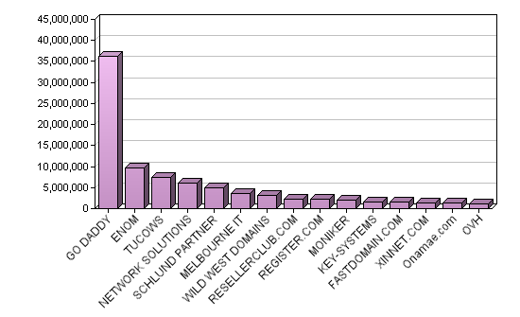
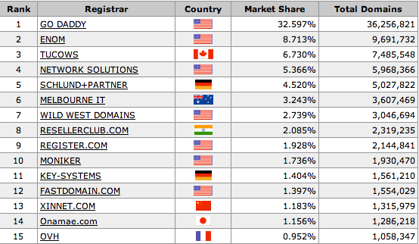
Internet Registrars Ranking

Slide 13
WHOIS
Unix line command
#whoisnmsu.edu
#whois 128.123.0.0
The registration for both the IP address and the Internet domain name can be verified using the whois protocol.
The whois protocol queries databases that store user registration information of an Internet domain name and IP space.
The whois information gives the ownership information that includes the point of contact of a resource.
There are many whois servers that are accessible via the web interface. All of these derive from the simple UNIX line command whois that is still available today.

Slide 14
Host Configuration
Most computers using TCP/IP need updated configuration information when they start up (boot).
Examples of that type of information include:
IP address and subnet mask.
Default gateway
Domain name server
Etc.
Two protocols are commonly used to supply the client with this information:
BOOTP (Bootstrap Protocol)
DHCP (Dynamic Host Configuration Protocol)

Slide 15
BOOTP
BOOTP – Bootstrap Protocol
BOOTPS - UDP port 67 on the server
BOOTPC – UDP port 68 used by the clients
BOOTP server
BOOTP record: MAC <-> IP database
assigns an fixed IP based on a the client MAC address
The IP and MAC addresses have a one-to-one relationship
Drawbacks
MAC addresses must be pre-registered
Inefficient IP space usage
Not Robust enough for mobility

Slide 16
DHCP
DHCP – Dynamic Host Configuration Protocol
BOOTPS - UDP port 67 on the server
BOOTPC – UDP port 68 used by the clients
Enhancement of BOOTP by implementing OPTIONS
Interoperate with BOOTP
Lease Time for an IP address
IP address can then be reassigned
Acquire ALL other IP configuration parameters
Windows Domain Controllers, Vendor Specific servers, and etc.

Slide 17
DHCP
Widely implemented - servers, routers, switches, and etc.
Pools, scopes, or ranges of IP addresses are set up and made available on each subnet for dynamic allocation by DHCP
ipdhcp pool dhcp1pool
network 172.20.224.0 255.255.255.0
dns-server 128.123.2.18
domain-name et477.com
default-router 172.20.224.1
ipdhcp pool dhcp2pool
network 172.20.240.0 255.255.255.0
dns-server 128.123.3.6
domain-name et477.net
default-router 172.20.240.1
!
ipdhcp excluded-address 172.20.224.0 172.20.224.10
ipdhcp excluded-address 172.20.240.0 172.20.240.10
1 Day lease time by default

Slide 18
DHCP
To verify the DHCP pool status and information
RouterA#showipdhcp pool
Pool dhcp1pool :
Utilization mark (high/low) : 100 / 0
Subnet size (first/next) : 0 / 0
Total addresses : 254
Leased addresses : 5
Pending event : none
1 subnet is currently in the pool :
Current index IP address range Leased addresses
172.20.224.132 172.20.224.1 - 172.20.224.254 5

Slide 19
DHCP
To view the IP address allocation by the server
RouterA#showipdhcp binding
Bindings from all pools not associated with VRF:
IP address Client-ID/ Lease expiration Type
Hardware address/
User name
172.20.224.12 0013.2126.9f2d Feb 12 2012 02:17 PM Automatic
172.20.224.47 0100.1143.bdda.03 Feb 12 2012 11:17 AM Automatic
172.20.224.53 0100.0f1f.e82f.45 Feb 12 2012 04:07 AM Automatic
172.20.224.62 0100.1143.11bb.ed Feb 12 2012 12:04 PM Automatic
172.20.224.114 0100.1143.11bc.5d Feb 12 2012 11:33 AM Automatic

Slide 20
DHCP
What happens when a DHCP server cannot be reached or there is a broken network path to the server?
A DHCP client will use a self-assigned IP address known as Automatic Private IP addressing (APIPA).
APIPA uses a reserved IP range of 169.254.1.0 – 169.254.254.255.
The client will select a random IP address in that range with a netmask of 255.255.0.0.
The client will then send a ARP packet asking for that IP address to see if any other machine is using it.
If there is an ARP reply by another machine, the client will generate another random IP address and try again.

Slide 21
DHCP
This could be deceiving to a typical user because it looks as if the machine is getting an IP address.
However, the machine will not be able to access the Internet.

Slide 22
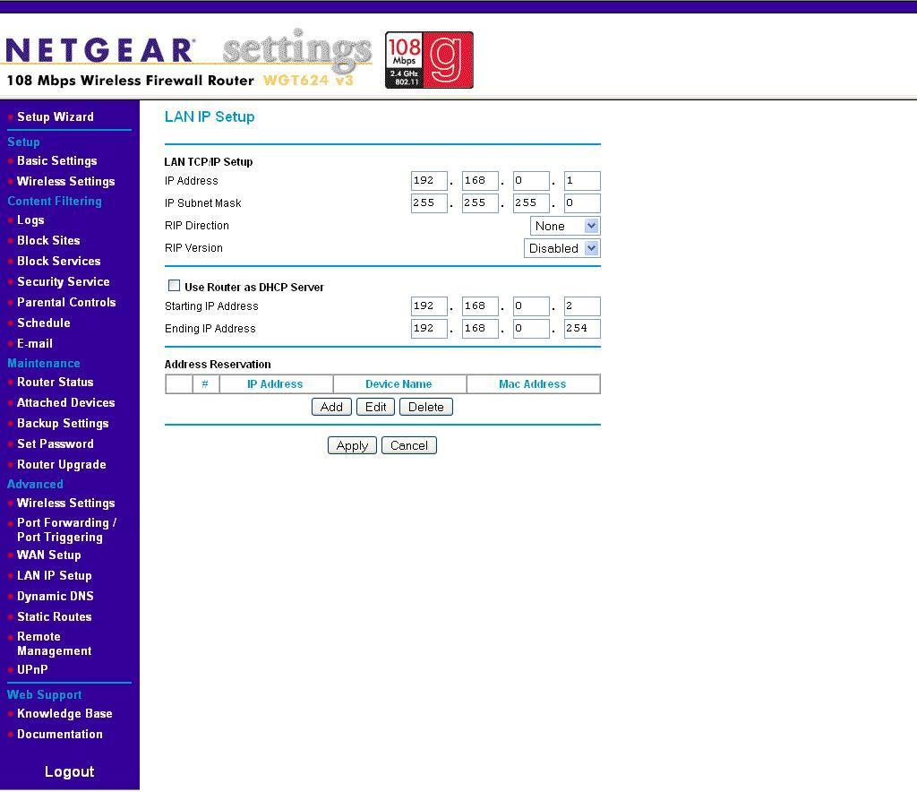
DHCP

Slide 23
DHCP
Designed to work on a local subnet
DHCP server and clients are on the same local subnet (broadcast domain)
On campus/enterprise with multiple networks
Routers don’t forward broadcast
DHCP relay is used to forward the DHCP broadcast to the DHCP server
Cisco Routers: ip helper-address
interface FastEthernet0/0
description NMSU-Carlsbad
ip address 128.123.116.1 255.255.252.0
ip helper-address 128.123.3.5
ip helper-address 128.123.2.19

Slide 24
IP Helper-Address
By default, the ip helper-address command will forward these 8 UDP ports:
UDP Port | Common Name
37 | Time Protocol
49 | TACACS
53 | DNS
67 | BOOTP/DHCPClient
68 | BOOTP/DHCPServer
69 | TFTP
137 | NetBios Name Service
138 | NetBios Datagram

Slide 25
DHCP Operation
DHCP Discover
This is a broadcast, meaning that the message is sent to all computers in the LAN.
DHCP Offer
the DHCP server listening on the LAN will take the packet, retrieve an available IP address from the address pool, and send the address to the client
DHCP Request
formally request and confirm the offered IP with the server
DHCP ACK
a unicast packet sent back to the client with the same IP information.

Slide 26
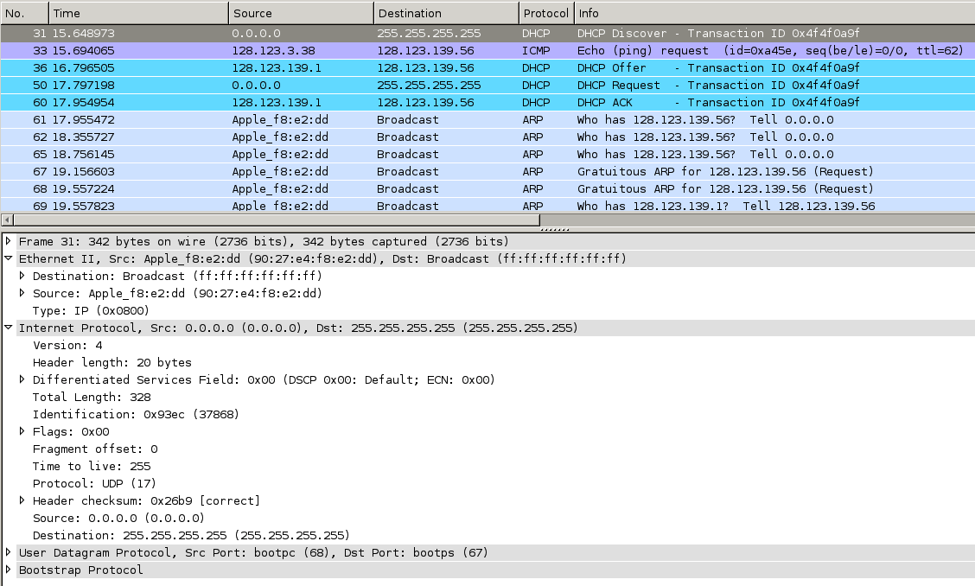
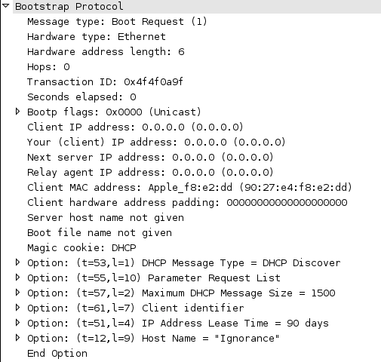
DHCP Discover packet

Slide 27
DHCP Discover packet

Slide 28
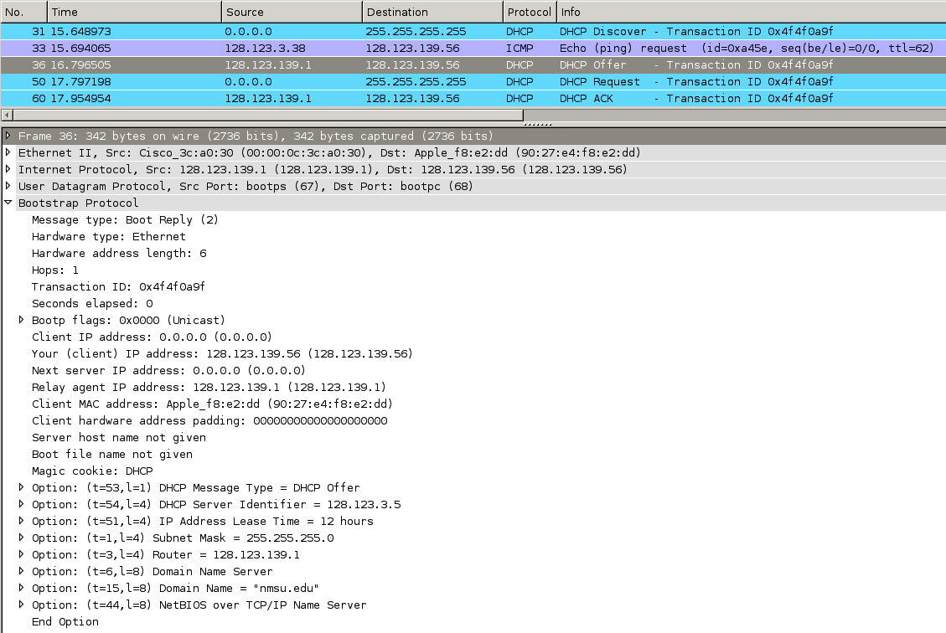
DHCP Offer packet

Slide 29
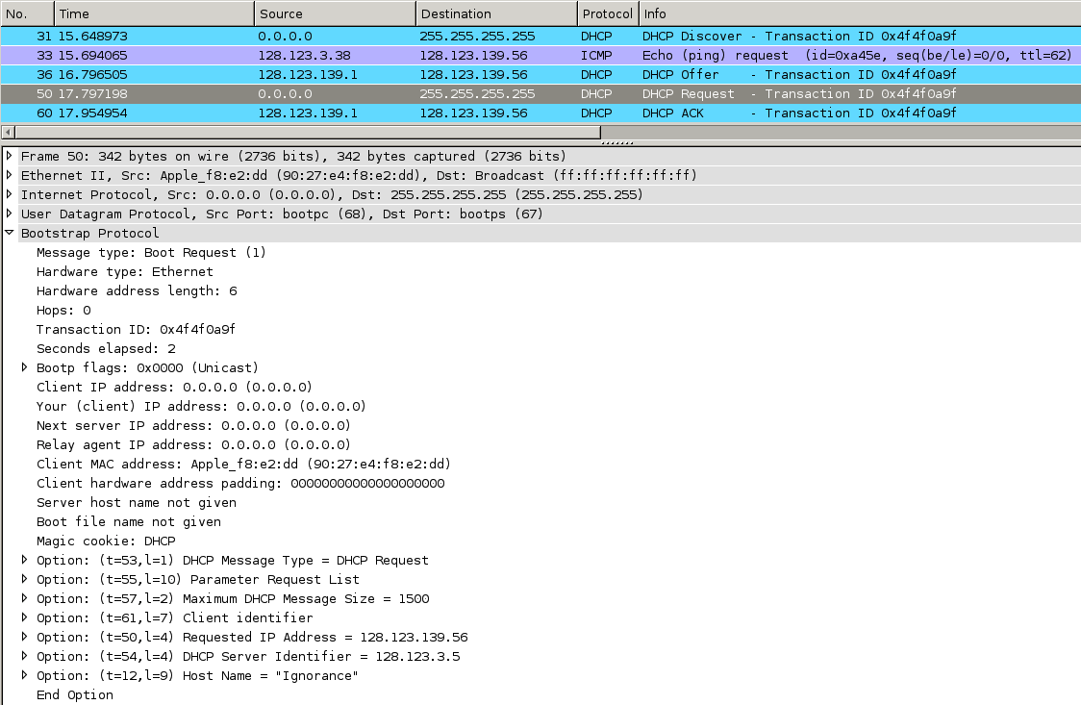
DHCP Request packet

Slide 30
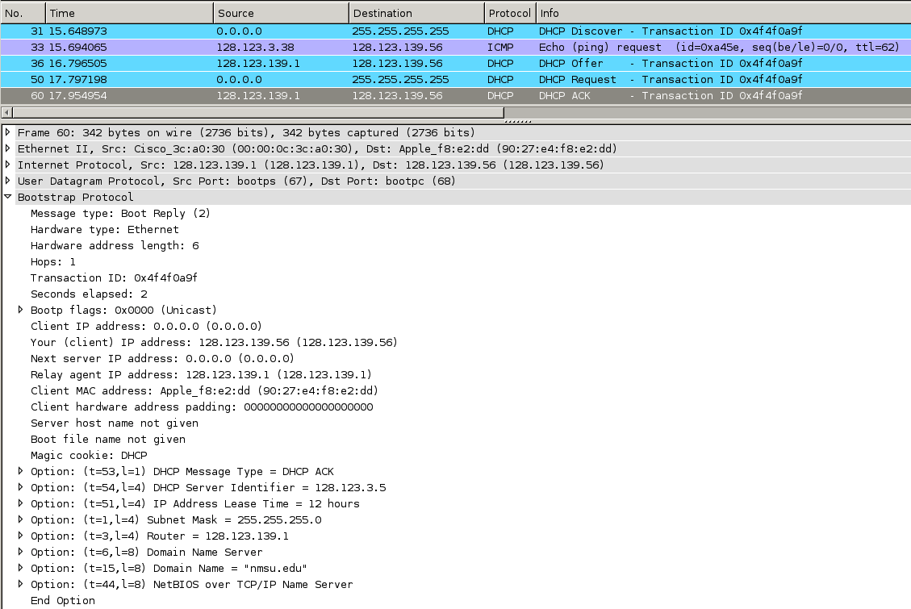
DHCP ACK packet

Slide 31
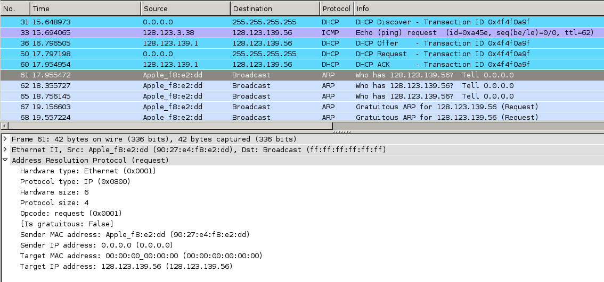

Slide 32
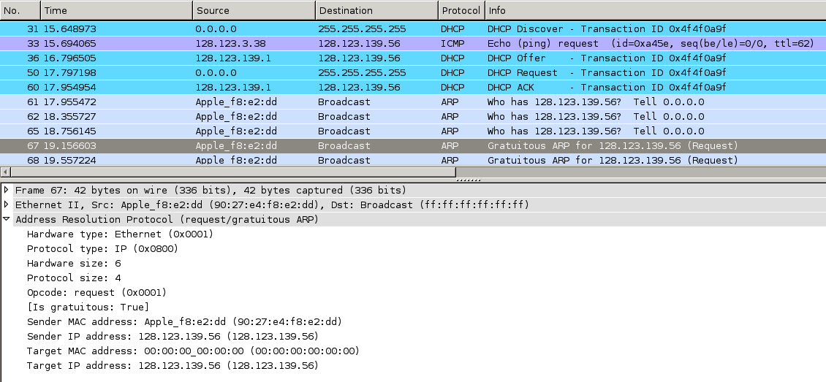

Slide 33
DHCP Security Drawback
Who is your DHCP server?
DHCP Client will accept the very first DHCP offer.
Rogue DHCP server
ipconfig /all
Why do we use central DHCP server instead of routers?
Centralize the control
One place to look for DHCP information

Slide 34
Chapter 10-4
Scaling the Network with
NAT and PAT

Slide 35
NAT and PAT
In most cases, the demand of IP network devices exceeds the number of public IP addresses assigned to them.
Most institutions have to use private IP addresses in their network. These private IP addresses must be able to communicate with outside or Internet hosts.
This cannot be done because the private IP addresses are not routable on the Internet.
These private IP addresses must be translated to public IP addresses using techniques like NAT (Network Address Translation) or PAT (Port Address Translation) for use on the Internet.

Slide 36
NAT
Network Address Translation is a technique used to translate an internal private IP address to a public IP address before the packets leave the local network to the public network.
NAT is typically implemented and deployed at the router facing the outside network.

Slide 37
NAT
NAT is a one-to-one translation of a private IP address to a public IP address.
This means for every connection made to the outside world, there must be a public IP address available.
The public IP address is relinquished when it is no longer used or when the NAT timeout occurs.
NAT is used not only for a way to communicate to the outside world; it can be used to hide the internal IP infrastructure of the network.

Slide 38
PAT
PAT is sometimes referred to as many-to-one NAT and NAT overload, because of its ability to translate many IP addresses with a single public IP address or a handful of public IP addresses.
PAT accomplishes this by utilizing the TCP/UDP ports.
The PAT process tracks a port number for the connection. The router stores the IP address and port number in a NAT lookup table.

Slide 39
PAT
The port number differentiates the computer that is establishing a connection to the Internet because the router uses the same public IP address for all computers.
This port number is used when a data packet is returned to the home network.
The port number identifies the computer that established the Internet connection, and the router can deliver the data packet to the correct computer.

Slide 40
PAT Example
For example, if computer 1 (10.0.0.1) establishes a connection to a website on the Internet.
The data packets from the website are sent back to computer 1 using the network’s routable public IP address (12.0.0.1).
.

Slide 41
This first step enables the data packet to be routed back to the home network.
Next, the router uses the NAT lookup table and port number to translate the destination for the data packet back to the computer 1 private IP address and original port number, which might be different.

Slide 42
This table demonstrates an example of a PAT table of a router. The router translates the private IP addresses to the public routable IP address assigned by the ISP.
Additionally, the router tracks a port number with the public IP address to identify the computer. For example, the computer with the private IP address of 10.0.0.1 is assigned the public IP address 12.0.0.1:2000, where 2000 is the port number tracked by the router.

Slide 43
Configuring NAT
The following example demonstrates how to define NAT points. The FastEthernet0/0 will be the inside interface and the FastEthernet0/1 will be the outside interface. To define the NAT area, the command ip nat inside/outside is used.
RouterA#conf t
Enter configuration commands, one per line. End with CNTL/Z.
RouterA(config)#
RouterA(config)# interface FastEthernet0/0
RouterA(config-if)# ip nat inside
RouterA(config)# interface FastEthernet0/1
RouterA(config-if)# ip nat outside

Slide 44
A graphical depiction of NAT inside and out.

Slide 45
Configuring NAT
After the NAT interfaces are defined, then a NAT statement can be configured.
There are several types of NAT. One of them is static NAT. A static NAT is a fixed one-to-one mapping of an inside IP address to an outside IP address.
The static NAT command is ip nat inside source static [local_ip] [global_ip]. The following example demonstrates how to configure a static NAT on a Cisco router.
RouterA(config)#
RouterA(config)# ip nat inside source static 10.0.0.5 12.0.0.5

Slide 46
Configuring NAT
RouterA(config)#
RouterA(config)# ip nat inside source static 10.0.0.5 12.0.0.5
The above command will map the inside private IP address of 10.0.0.5 to the outside public IP address of 12.0.0.5 entirely.
There is no port translation when the internal host 10.0.0.5 is making a connection outside. This host appears to the outside world as 12.0.0.5 and it is accessible from the outside via the very same public IP address.

Slide 47
Configuring NAT
A better approach is to expose only network ports that need to be accessible by the external network.
The following example demonstrates how to configure static NAT statements to map TCP port 80 of the inside host to TCP port 80 of the outside public IP address as well as TCP port 443 to cover all web traffic ports.
RouterA(config)#
RouterA(config)# ip nat inside source static tcp 10.0.0.5 80 12.0.0.5 80
RouterA(config)# ip nat inside source static tcp 10.0.0.5 443 12.0.0.5 443

Slide 48
Configuring NAT
Another type of NAT configuration is dynamic NAT. Dynamic NAT is a one-to-one mapping from an available global pool of IP addresses assigned to a router.
A router is assigned a pool of IP addresses that contains global IP addresses, every inside host tries to access a public network will be given an IP from the global pool.
The following example shows step-by-step configuration.
RouterA(config)#
RouterA(config)# ip nat pool global_ip 12.0.0.6 12.0.0.26 netmask 255.255.255.0
RouterA(config)# access-list 1 permit 10.0.0.0 0.0.0.255
RouterA(config)# ip nat inside source list 1 pool global_ip

Slide 49
Configuring PAT
Another type of NAT configuration is NAT overload or PAT. Similar to dynamic NAT, a pool of global IP addresses and an access list containing allowable inside IP addresses must be defined.
The following example shows step-by-step configuration.
RouterA(config)#
RouterA(config)# ip nat pool global_ip 12.0.0.6 12.0.0.26 netmask 255.255.255.0
RouterA(config)# access-list 101 permit ip 10.0.0.0 0.0.0.255 any
RouterA(config)# ip nat inside source list 101 pool global_ip overload

Slide 50
Configuring PAT
If one cannot acquire a pool of global IP address from an ISP, then the NAT overload will have to be configured using the router interface facing the public network. This interface will have a public IP address assigned to it.
A NAT overload can then be configured to use the interface’s IP address as the global address. In this case, the global IP pool is not needed, only an access list is required. The following example shows step-by-step configuration.
RouterA(config)#
RouterA(config)# access-list 101 permit ip 10.0.0.0 0.0.0.255 any
RouterA(config)# ip nat inside source list 101 interface FastEthernet0/1 overload

Slide 51
show ip nat translation
To display active translations, the command show ip nat translation is used. The command will show the active NAT table in column format.
RouterA# show ip nat translation
Pro Inside global Inside local Outside local Outside global
tcp 12.0.0.2:57425 10.10.70.5:57425 74.125.227.20:80 74.125.227.20:80
tcp 12.0.0.2:57426 10.10.70.5:57426 74.125.227.17:80 74.125.227.17:80
The column Pro is the protocol (TCP, UDP, ICMP) being translated.

Slide 52
RouterA# show ip nat translation
Pro Inside global Inside local Outside local Outside global
tcp 12.0.0.2:57425 10.10.70.5:57425 74.125.227.20:80 74.125.227.20:80
tcp 12.0.0.2:57426 10.10.70.5:57426 74.125.227.17:80 74.125.227.17:80
The “Inside global” is the global IP address used by the inside IP address after the NAT process.
The “Inside local” is the inside IP address.
The “Outside local” corresponds to the destination IP address of the inside local before the NAT translation.
The “Outside global” corresponds to the destination IP address of the inside global after the NAT translation.

Slide 53
DNS
DNS is the Domain Name Service. DNS translates a human readable name to an IP address or an IP address to a domain name.
The translation of a name to an IP address is called forward domain name service
The translation of an IP address to a domain name is called reverse domain name service.
UDP Port 53

Slide 54
DNS Tree Hierarchy
The domain name service is a tree hierarchy. It starts with the root servers, top level domains then extends to sub domains.

Slide 55
DNS Tree Hierarchy
Country domains are usually defined by two letters such as United States (.us) and Canada (.ca) The primary domain server for that domain has to exist in the same country.

Slide 56
Root Servers
IANA manages the DNS root zone for the generic top-level domains (gTLDs) and country-code top-level domains (ccTLDs)
A group of well known IP addresses that have been programmed into DNS servers.
When the DNS service is installed on a server, the root server’s IP addresses are automatically configured in the DNS.

Slide 57
Root Servers
Root servers only delegates.
The root servers only have information about the next level in the tree.
Root servers only know about the top level domains(e.g. .com, .gov, .mil, etc.) name servers.
They will not know anything about www.et477.com.
They only know the .com domain name server’s IP address.
The network/campus DNS server will query the root servers to try to find name servers of known domains.

Slide 58
Root Servers

Slide 59
Domain Name Service Tree Hierarchy
Root Servers
.com .mil .edu .net .org .gov
.us .ca .info .biz .tv
Subdomains
Top Level Domains (TLD)

Slide 60
Domain Name Service Tree Hierarchy
Root Servers
.com .mil .edu .net .org .gov
.us .ca .info .biz .tv
Subdomains
Top Level Domains (TLD)
A machine on Network-A wants to know the IP address of the www server at Cisco.com

Slide 61
Domain Name Service Tree Hierarchy
Root Servers
.com .mil .edu .net .org .gov
.us .ca .info .biz .tv
Subdomains
Top Level Domains (TLD)
A machine on Network-A sends a DNS query to its DNS server asking for the IP address of the www.cisco.com

Slide 62
Domain Name Service Tree Hierarchy
DNS Query
Root Servers
.com .mil .edu .net .org .gov
.us .ca .info .biz .tv
Subdomains
Top Level Domains (TLD)
The DNS server on Network-A queries the one of the Root servers for the IP address of www.cisco.com

Slide 63
Domain Name Service Tree Hierarchy
Root Servers
.com .mil .edu .net .org .gov
.us .ca .info .biz .tv
Subdomains
Zone Delegation
Top Level Domains (TLD)
A root server returns a list of name servers for the .com domain

Slide 64
Domain Name Service Tree Hierarchy
Root Servers
.com .mil .edu .net .org .gov
.us .ca .info .biz .tv
Subdomains
Top Level Domains (TLD)
Network-A DNS queries a .com name
Server for the IP address of
www.cisco.com

Slide 65
Domain Name Service Tree Hierarchy
Root Servers
.com .mil .edu .net .org .gov
.us .ca .info .biz .tv
Subdomains
Top Level Domains (TLD)
Zone Delegation
A .com name server returns a list of name servers for cisco.com domain

Slide 66
Domain Name Service Tree Hierarchy
Root Servers
.com .mil .edu .net .org .gov
.us .ca .info .biz .tv
Top Level Domains (TLD)
Cisco.com
Network-A DNS then queries a cisco.com domain name server for the IP address of thewww.cisco.com

Slide 67
Domain Name Service Tree Hierarchy
Root Servers
.com .mil .edu .net .org .gov
.us .ca .info .biz .tv
Top Level Domains (TLD)
Cisco.com
A cisco.com domain name server returns the IP address of the www.cisco.com
This is said to be an authoritative answer

Slide 68
DNS Lookup Process
1) Querying the one of the ROOT Servers
List of ROOT servers programmed in the DNS Server
Ignorance:~ piyasat$ dig +trace www.google.com
; <<>>DiG 9.6.0-APPLE-P2 <<>> +trace www.google.com
;; global options: +cmd
. 348805 IN NS h.root-servers.net.
. 348805 IN NS i.root-servers.net.
. 348805 IN NS j.root-servers.net.
. 348805 IN NS k.root-servers.net.
. 348805 IN NS l.root-servers.net.
. 348805 IN NS m.root-servers.net.
. 348805 IN NS a.root-servers.net.
. 348805 IN NS b.root-servers.net.
. 348805 IN NS c.root-servers.net.
. 348805 IN NS d.root-servers.net.
. 348805 IN NS e.root-servers.net.
. 348805 IN NS f.root-servers.net.
. 348805 IN NS g.root-servers.net.
;; Received 500 bytes from 128.123.3.5#53(128.123.3.5) in 9 ms

Slide 69
DNS Lookup Process
2) Querying one the .com DNS Servers
List of the .net DNS servers returned by the ROOT server e.root-servers.net
com. 172800 IN NS c.gtld-servers.net.
com. 172800 IN NS l.gtld-servers.net.
com. 172800 IN NS d.gtld-servers.net.
com. 172800 IN NS h.gtld-servers.net.
com. 172800 IN NS a.gtld-servers.net.
com. 172800 IN NS i.gtld-servers.net.
com. 172800 IN NS j.gtld-servers.net.
com. 172800 IN NS k.gtld-servers.net.
com. 172800 IN NS g.gtld-servers.net.
com. 172800 IN NS b.gtld-servers.net.
com. 172800 IN NS f.gtld-servers.net.
com. 172800 IN NS m.gtld-servers.net.
com. 172800 IN NS e.gtld-servers.net.
;; Received 500 bytes from 192.203.230.10#53(e.root-servers.net) in 91 ms

Slide 70
DNS Lookup Process
3) Querying the GOOGLE.COM authoritative DNS Servers
List of the google.com authoritative DNS servers returned by a .com TLD DNS server d.gtld-servers.net
google.com. 172800 IN NS ns2.google.com.
google.com. 172800 IN NS ns1.google.com.
google.com. 172800 IN NS ns3.google.com.
google.com. 172800 IN NS ns4.google.com.
;; Received 168 bytes from 192.31.80.30#53(d.gtld-servers.net) in 103 ms
www.google.com. 604800 IN CNAME www.l.google.com.
www.l.google.com. 300 IN A 74.125.224.208
www.l.google.com. 300 IN A 74.125.224.210
www.l.google.com. 300 IN A 74.125.224.211
www.l.google.com. 300 IN A 74.125.224.209
www.l.google.com. 300 IN A 74.125.224.212
;; Received 132 bytes from 216.239.38.10#53(ns4.google.com) in 105 ms
The IP addresses of the host name www.google.com returned by one of its authoritative servers, ns4.google.com

Slide 71
Authoritative Name Servers
Authoritative Name Server is a name server that is configured to answer DNS queries for a particular domain or zone.
For example, 128.123.3.5 and 128.123.2.19 are authoritative name servers for domain nmsu.edu.
dig noc.nmsu.edu, nslookupnoc.nmsu.edu
dig www.unm.edu, dig www.unm.edu
As part of the domain registration, the authoritative name servers must be specified

Slide 72
Authoritative Name Servers
When a name server answers a DNS query that is not in its authorized domain/zone, the DNS answer is said to be a “Non-authoritative answer”
A DNS server can also query or contact other DNS servers on behalf of the requesting client to fully resolve the name, then send an answer back to the client. This process is known as recursion
Only name servers that are configured to be a Recursive Name Server can perform this function – Recursive Lookup.
*
Is Recursion good? – set server to hati.unm.edu

Slide 73
DNS Lookup Process
When a host pings www.checs.net, the host computer first checks its DNS cache, assuming the DNS cache is empty, the host then sends a DNS request to the campus DNS server.
Windows: ipconfig /flushdns
Mac: dscacheutil –flushcache
Linux: /etc/rc.d/init.d/nscd restart

Slide 74
DNS Lookup Process
Typically the host will know the IP addresses of the primary and secondary DNS server either through static input or dynamic assignment.
The request is sent to the primary DNS server requesting the IP address for www.checs.net.
If the primary DNS server happens to be the authority for the domain checs.net and knows the IP address of the hosts in the network.
The primary DNS server returns the IP address of www.checs.net and then the ICMP process associated with a ping is started.

Slide 75
DNS Lookup Process
If the primary DNS server is not the authority for the domain checs.net
The server first checks its DNS cache. Assuming its DNS cache is empty
The server then verifies its Recursion configuration. Assuming the server is configured to perform recursive lookup.
Then it sends a DNS request to one of the ROOT servers.
Lets the domain delegation lookup begin.

Slide 76
DNS Records
A (Address) record – a Hostname, which maps to an IP address
Forward name lookup
Nslookup, dig
Query different name server
nslookup, server 128.123.3.6
dig @128.123.3.6

Slide 77
DNS Records
PTR (Pointer) record – an IP address, which maps to a hostname
Reverse name lookup
Special reverse domain called “in-addr.arpa”, where arpa(Address and Routing Parameter Area) is the TLD for the reverse domain.
128.123.3.6 -> 6.3.123.128.in-addr.arpa
nslookup, set type=ptr
dig 6.3.123.128.in-addr.arpa or dig –x 128.123.3.6
DNS records have been known to be a challenge for many network administrators

Slide 78
Forward Lookup Process
Ignorance:~ piyasat$ dig +trace www.checs.net
; <<>>DiG 9.6-ESV-R4-P3 <<>> +trace www.checs.net
;; global options: +cmd
. 86100 IN NS l.root-servers.net.
. 86100 IN NS m.root-servers.net.
. 86100 IN NS f.root-servers.net.
. 86100 IN NS j.root-servers.net.
. 86100 IN NS g.root-servers.net.
. 86100 IN NS i.root-servers.net.
. 86100 IN NS a.root-servers.net.
. 86100 IN NS d.root-servers.net.
. 86100 IN NS b.root-servers.net.
. 86100 IN NS e.root-servers.net.
. 86100 IN NS h.root-servers.net.
. 86100 IN NS k.root-servers.net.
. 86100 IN NS
1
2
checs.net. 172800 IN NS dns1.nmsu.edu.
checs.net. 172800 IN NS ns1.checs.net.
;; Received 108 bytes from 192.35.51.30#53(f.gtld-servers.net) in 131 ms
www.checs.net. 3600 IN A 206.206.155.4
checs.net. 3600 IN NS ns1.checs.net.
checs.net. 3600 IN NS dns1.NMSU.Edu.
;; Received 124 bytes from 128.123.3.5#53(dns1.nmsu.edu) in 60 ms

Slide 79
Reverse Lookup Process
ignorance:~ piyasat$ dig +trace -x 206.206.155.4
; <<>>DiG 9.6.0-APPLE-P2 <<>> +trace -x 206.206.155.4
;; global options: +cmd
. 328749 IN NS b.root-servers.net.
. 328749 IN NS c.root-servers.net.
. 328749 IN NS d.root-servers.net.
. 328749 IN NS e.root-servers.net.
. 328749 IN NS f.root-servers.net.
. 328749 IN NS g.root-servers.net.
. 328749 IN NS h.root-servers.net.
. 328749 IN NS i.root-servers.net.
. 328749 IN NS j.root-servers.net.
. 328749 IN NS k.root-servers.net.
. 328749 IN NS l.root-servers.net.
. 328749 IN NS m.root-servers.net.
. 328749 IN NS a.root-servers.net.
;; Received 500 bytes from 128.123.3.5#53(128.123.3.5) in 9 ms
1
2
206.in-addr.arpa. 86400 IN NS W.ARIN.NET.
206.in-addr.arpa. 86400 IN NS Y.ARIN.NET.
206.in-addr.arpa. 86400 IN NS DILL.ARIN.NET.
206.in-addr.arpa. 86400 IN NS V.ARIN.NET.
206.in-addr.arpa. 86400 IN NS U.ARIN.NET.
206.in-addr.arpa. 86400 IN NS Z.ARIN.NET.
206.in-addr.arpa. 86400 IN NS T.ARIN.NET.
206.in-addr.arpa. 86400 IN NS X.ARIN.NET.
;; Received 183 bytes from 192.203.230.10#53(e.root-servers.net) in 90 ms
3
206.206.in-addr.arpa. 86400 IN NS ns.utah.edu.
206.206.in-addr.arpa. 86400 IN NS ns1.westnet.net.
;; Received 98 bytes from 204.61.216.50#53(U.ARIN.NET) in 27 ms
155.206.206.in-addr.arpa. 432000 IN NS dns1.checs.net.
155.206.206.in-addr.arpa. 432000 IN NS dns1.nmsu.edu.
;; Received 99 bytes from 128.138.213.13#53(ns1.westnet.net) in 16 ms
4.155.206.206.in-addr.arpa. 3600 IN PTR www.checs.net.
155.206.206.in-addr.arpa. 3600 IN NS ns1.checs.net.
155.206.206.in-addr.arpa. 3600 IN NS dns1.NMSU.Edu.
;; Received 148 bytes from 128.123.3.5#53(dns1.nmsu.edu) in 1 ms

Slide 80
Reverse Lookup
Not every IP address has a corresponding PTR record or their PTR doesn't match up with their A record.
A Record
PTR Record
[piyasat@noc ~]$ dig www.lascruces.org
;; QUESTION SECTION:
;www.lascruces.org. IN A
;; ANSWER SECTION:
www.lascruces.org. 7200 IN A 50.23.194.214
;; AUTHORITY SECTION:
lascruces.org. 86399 IN NS ns33.worldnic.com.
lascruces.org. 86399 IN NS ns34.worldnic.com.
;; Query time: 364 msec
;; SERVER: 206.206.155.2#53(206.206.155.2)
;; WHEN: Sun Feb 26 20:39:52 2012
;; MSG SIZE rcvd: 101
[piyasat@noc ~]$ dig -x50.23.194.214
;; QUESTION SECTION:
;214.194.23.50.in-addr.arpa. IN PTR
;; ANSWER SECTION:
214.194.23.50.in-addr.arpa. 86400 IN PTR 50.23.194.214-static.reverse.softlayer.com.
;; AUTHORITY SECTION:
194.23.50.in-addr.arpa. 86400 IN NS ns2.arpa.global-datacenter.com.
194.23.50.in-addr.arpa. 86400 IN NS ns1.arpa.global-datacenter.com.
;; ADDITIONAL SECTION:
ns1.arpa.global-datacenter.com. 9269 IN A 67.228.254.20
ns2.arpa.global-datacenter.com. 9269 IN A 67.228.255.20
;; Query time: 236 msec
;; SERVER: 206.206.155.2#53(206.206.155.2)
;; WHEN: Sun Feb 26 20:40:13 2012
;; MSG SIZE rcvd: 247

Slide 81
DNS Records
CNAME (Canonical) record – An name alias to an A record
nslookupwww.nmsu.edu
dig www.nmsu.edu
NS (Name Server) record – The authoritative name server of the domain/zone
Every domain name must have an NS record
NS must be an A record
nslookup, set type=NS
dig nmt.edu NS

Slide 82
DNS Records
MX (Mail Exchange) record – The Mail server of the domain/zone.
The e-mail server(s) where all the e-mails to the domain will be delivered.
MX must be an A record
nslookup, set type=MX
dig lcps.k12.nm.us MX
Each MX record has 2 pieces of information associated with it.
“Preference" number
The domain name of the mail server.
If there are multiple MX records, the SMTP server will pick one based on the preference level (starting with the lowest preference number, working its way up). It's O.K. to have more than one MX record with the same preference.
dig state.nm.us MX

Slide 83
Sending Email
Email settings typically consist of incoming mail server and outgoing mail server
When you send e-mail to someone, your e-mail typically goes from your e-mail client to an outgoing mail server (SMTP server)
SMTP (Send Mail Transfer Protocol) Server acts as a mailman delivering e-mails to the destination for you.

Slide 84
Sending Email
The SMTP server then checks for the MX record of the domain in the e-mail address.
For example, with "joe@example.com", it would look for the MX record for example.com.
So, the SMTP server then connects via TCP port 25 to the example.com e-mail server specified in the MX record.

Slide 85
MX Records
Obviously, if the MX records are incorrect, the e-mails will not be delivered. The followings are some cases.
No MX records.
The MX record points to a CNAME record (cannot be an alias).
The MX record points to an IP address. If so, mail servers probably will not deliver mail to you!
The MX record points to an A record with invalid IP address

Slide 86
E-mail Problem?
The PTR DNS records in the reverse DNS can be used for a number of things, including Spam Filtering.
Most e-mail servers use a technique called forward-confirmed reverse DNS (FCrDNS) verification.
This verification is to validate the authenticity of the domain name and the IP address.

Slide 87
Email Problem?
A reverse DNS lookup (PTR query) is performed on the IP address of the connecting mail server, which returns a list of zero or more PTR records.
An SMTP server with an IP of 4.3.1.2 from the domain source.comsends an e-mail to destination.com domain
the receiving destination.com e-mail server sees that the IP address 4.3.2.1 is connecting to its SMTP port (TCP 25).
The receiving e-mail server performs a reverse DNS lookup against this IP address.
The e-mail server must find a PTR for 4.3.2.1 pointing to a valid host record (A Record), otherwise the connection is rejected.

Slide 88
E-mail Problem?
Then for each domain name returned in the PTR query results, a regular 'forward' DNS lookup (type A query) is then performed on that domain name.
the receiving destination.com e-mail server performs a forward name lookup on the returned host name (A record).
If there is no IP address associated with the A record, the connection is rejected.
3. Any A record returned by the query is then compared against the original IP address, and if there is a match, then the full FCrDNS check passes.
Most e-mail servers perform only #1 and #2 check
Most people don’t even realize about the PTR records and most of them don’t know whether their PTR DNS servers are working correctly!!!

Slide 89
E-mail Problem?
Sender Address Verification Technique
The receiving email server verifies the validity of the email by checking the domain name from the sender email address.
the receiving destination.com e-mail server examines the sender’s e-mail address, joe@source.com.
It will lookup the MX record for source.com and validates it. If the validation fails, the connection is rejected.

Slide 90
DNS Records
TXT (Text) record – comments or notes :)
To associate some arbitrary information and text to a host or a domain.
Cleverly used to validate the authenticity of the domain
Cloud Mail
Cleverly used to validate legitimate email sources from the domain
Sender Policy Framework (SPF) data
nslookup, set type=TXT
dig alumni.nmsu.edu TXT

Slide 91
DNS Records
SRV (Service) record – service location
To identify the host(s) that offer specific type of service.
LDAP service, Active directory domain controllers, Voice over IP
_service._protocol.domainname
_ldap._tcp.nmsu.edu, _sip._udp.et477.com
Nslookup, set type=SRV
dig _vlmcs._tcp.nmsu.edu. SRV

Slide 92
Microsoft SRV records
Microsoft Active Directory
DNS + LDAP (Lightweight Directory Access Protocol)
_ldap._tcp.engr.ad.nmsu.edu
_kerberos._tcp.engr.ad.nmsu.edu

Slide 93
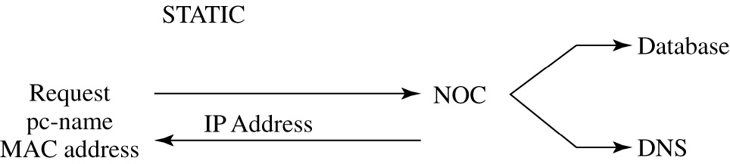
Manually adding a client to the network
A client PC updates the “A” record when an IP address is requested for a computer. The user obtain’s the pc-name and the pc’s MAC address. This information is sent to the network operation center (NOC). NOC issues an IP address to the client, updates the NOC database of clients on the network, and enters a new “A” record into the primary DNS. The entry is only made on the primary DNS. The entry will be later duplicated on the secondary DNS.
Name IP address MAC address
pc-salsa1-1 10.10.20.1 00-10-A4-13-6C-6E

Slide 94
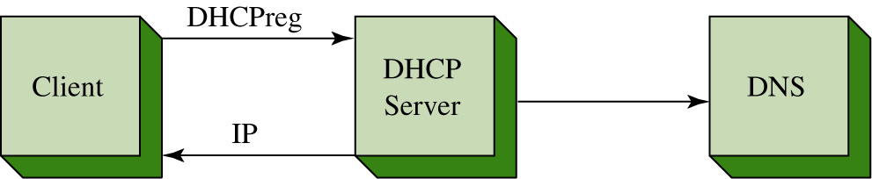
Dynamically adding a client to the network
A new “A” record can be entered dynamically when the client computer obtains an IP address through DHCP registration. This is graphically depicted above.
The DHCP server will issue an IP address to the client and at the same time send an updated “A” record to the network’s primary DNS. Once again, the client name and the IP and MAC address are stored in the “A” record.

Slide 95
SNMP
A fundamental network management tool is SNMP, the Simple Network Management Protocol.
SNMP, developed in 1988, is widely supported in most modern network hardware. SNMP is a connectionless protocol using the UDP (User Datagram Protocol) for the transmission of data to and from UDP port 161.

Slide 96
MIB
SNMP uses a Management Information Base (MIB) which is a collection of standard objects that are used to obtain configuration parameters and performance data on a networking device such as a switch or router.
For example, the MIB (ifDescr) returns a description of the router’s interfaces. An example next shown.

Slide 97
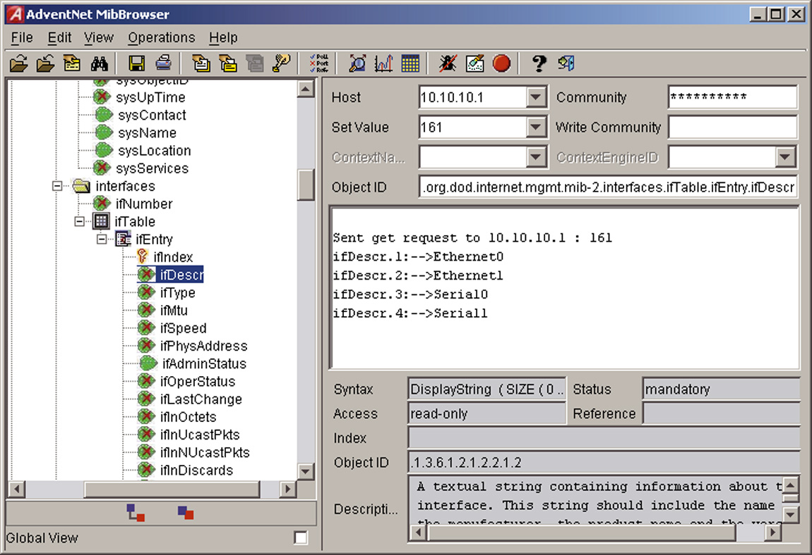
An SNMP software tool was used to collect the interface description information. The IP address of the router is 10.10.10.1 and a “get request ifDescr” was sent to port 161, the UDP port for SNMP. The descriptions of the interfaces were returned as shown.

Slide 98
Configuring SNMP - Router
Obtaining the SNMP data requires that SNMP be configured on the switch or router. The first step for configuring SNMP on a Cisco router is to enter the router’s configuration mode using the conf t command.
Switch-B#conf t
Enter configuration commands, one per line. End with CNTL/Z.
From the switch or router’s (config)# prompt enter the command snmp community [community string] [permissions]. The community string can be any word. The permissions field is used wo establish if the user can read only (ro), write only (wo), or both (rw). The options for the configuring SNMP on the switch or router are shown.
Switch-B(config)#snmp community ?
WORD SNMP community string

Slide 99
Configuring SNMP - Router
The router’s configuration mode was entered and the snmp community public ro command was issued.
The word public is used as the community string. The community string is the password used by the SNMP software to access SNMP (port 161) on the router. The ro sets the permission to read-only.
Switch-B(config)#snmp community public ro

Slide 100
Configuring SNMP - Router
In the next example, the community string password is set to makesecret and the permission is set to read-write (rw). Once again, the router’s (config)# mode is entered and the command snmp community makesecret rw is entered.
Switch-B(config)#snmp community makesecret rw

Slide 101
Configuring SNMP - Router
The configuration for SNMP can be verified using the show run command from the switch or router’s privileged mode prompt. A portion of the configuration file is shown that lists the SNMP configuration.
Switch-B#sh run
.
.
snmp-server community makesecret RW

Slide 102
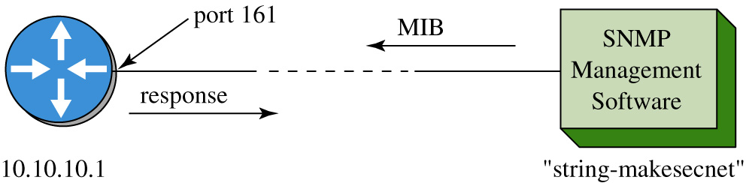
This figure shows the set-up of the configured router and the computer running the SNMP management software. The SNMP management software issues the MIB to the router at port 161 and the router returns the response.

Slide 103
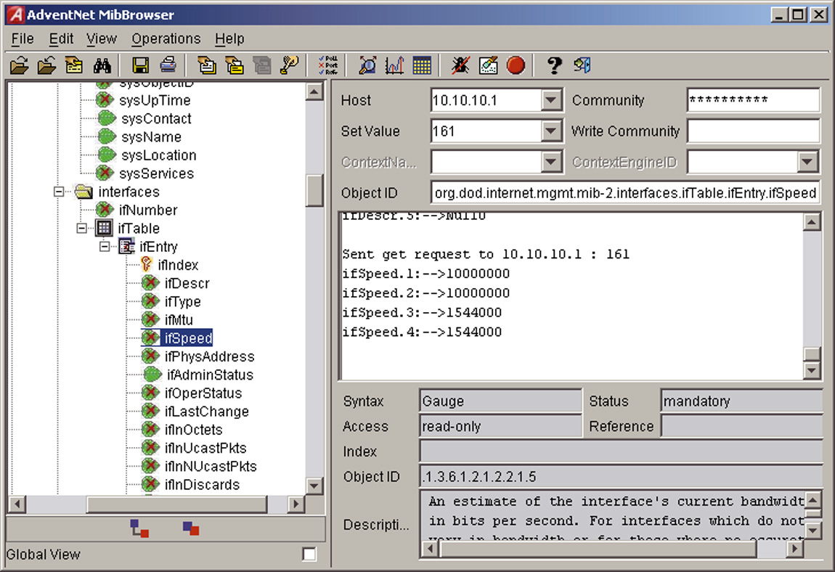
This slide shows another example of using SNMP to obtain interface information about a router. The SNMP manager was configured with the Host IP address of 10.10.10.1, a set value (port #) of 161 and the 10 character community string of makesecret shown as * * * * * * * * * *. The MIB (ifspeed) was sent to the router and a status for each of the interfaces was provided. The data displayed shows the speed settings for the router’s interfaces.

Slide 104
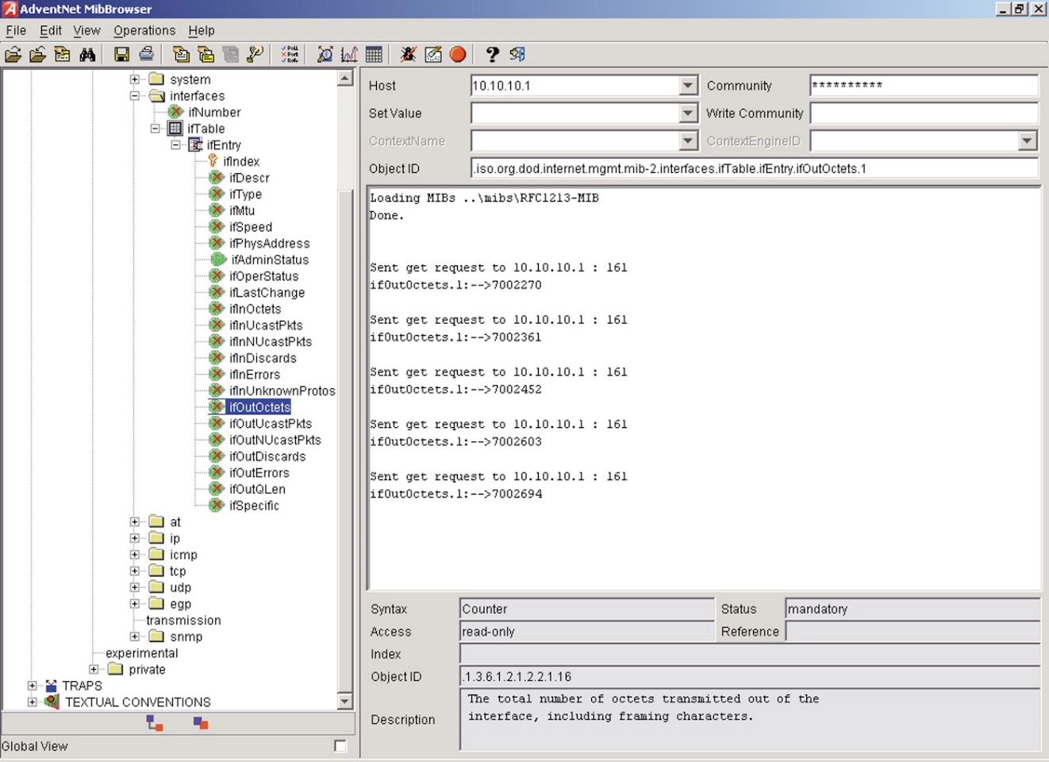
Another important application of SNMP is for obtaining traffic data statistics. An example of this is shown. The SNMP management program issued the MIB (ifOutOctets) which returns the number of octets of data that have left the router. The router has a counter that keeps track of the number of octets that have left the router. The first result shows ifoctets = 7002270. The next result display shows that the ifoctets returns a value of 7002361.

Slide 105
The SNMP management program collecting the statistics keeps track of the time interval between measurements and the number of octets that have passed. This information can be used to calculate the average traffic flow by hour, day, week, or , month, depending on the information needed. An example of collecting traffic route statistics is provided in section 9.6. A final note about the router’s counter, the counter does not reset unless the router is rebooted.

